Slide 1
Mini-Research Project
Anastasiia, Bram, Jasper, Lasse

Slide 2
01
Introduction
Research question:
“How can we predict the popularity of a Spotify song based on its features?”
Relevance:
To see if certain characteristics of a song (that we may not be conscious about) are able to predict its popularity
Analysis:
DV: Stream
IV: Danceability + Energy + Loudness + Speechiness + Acousticness + Instrumentalness + Liveness + Valence + Tempo + Duration
Multiple and multivariate regression analysis

Slide 3
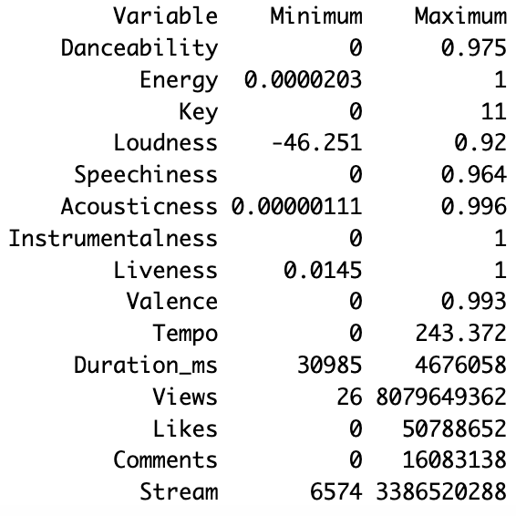
02
Descriptives
19063 observations

Slide 4
03
Method
Multiple and multivariate regression analysis
Removing all NA’s
Subsetting relevant variables into new dataset
Creating model and selecting significant predictors
Stream ~ Danceability + Energy + Loudness + Speechiness + Acousticness + Instrumentalness + Liveness + Valence

Slide 5
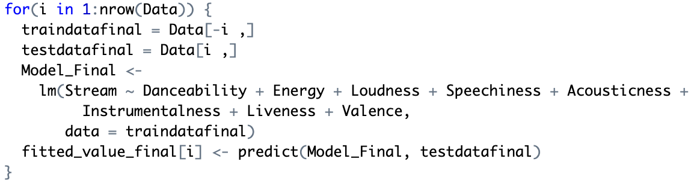
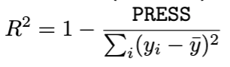
04
Analysis
LOOCV →
Model Quality →

Slide 6
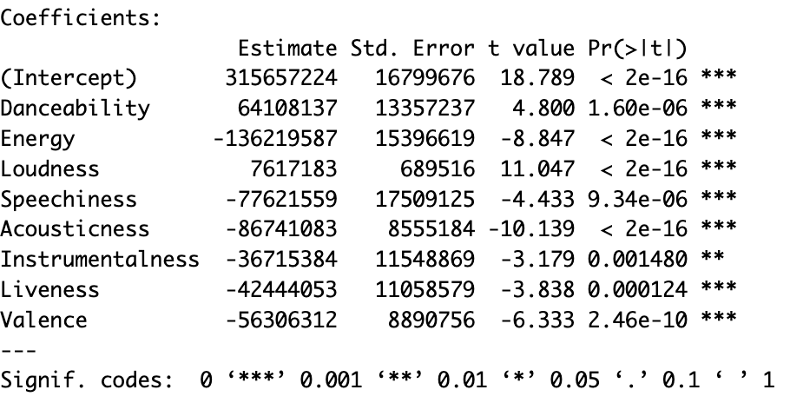
05
Results
F-statistic: 73.49 on 8 and 19053 DF, p-value: <2.2e-16
Model Quality Adjusted-R^2 = 0.02953
RMSE = 244603778

Slide 7
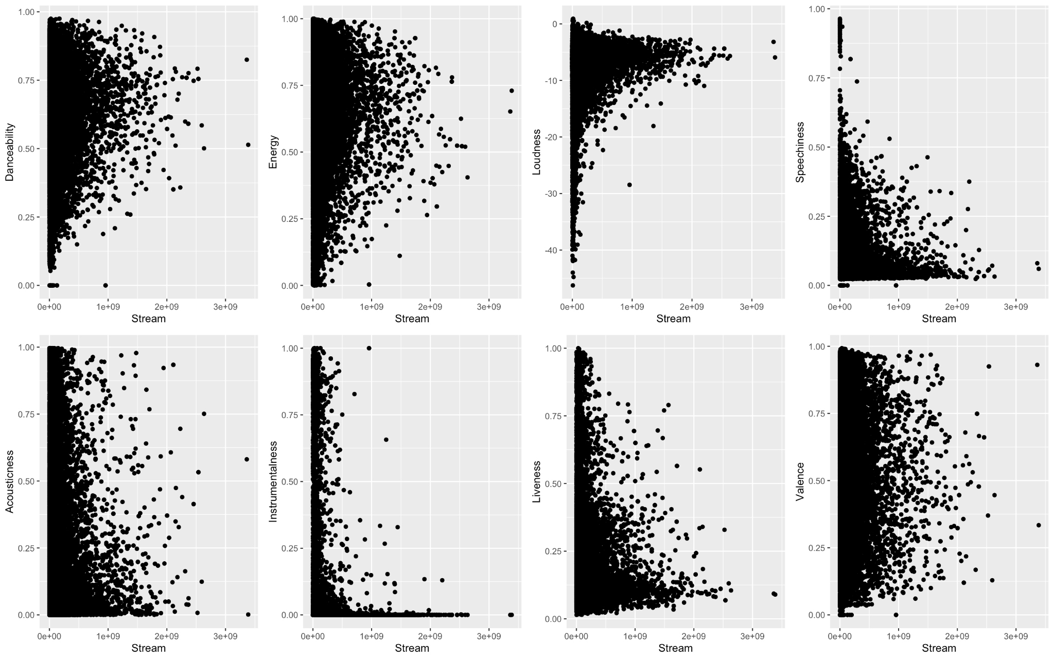
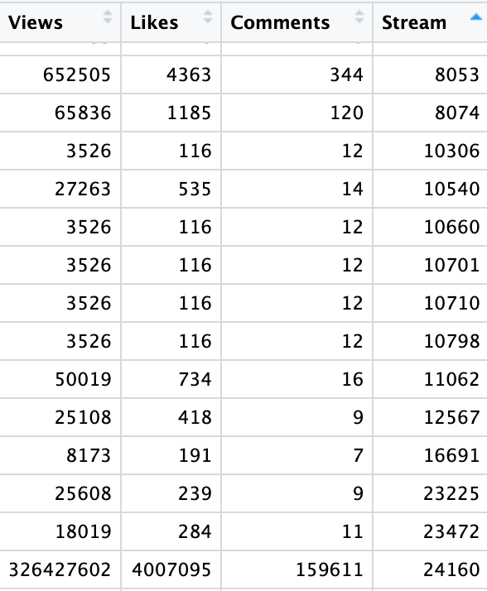
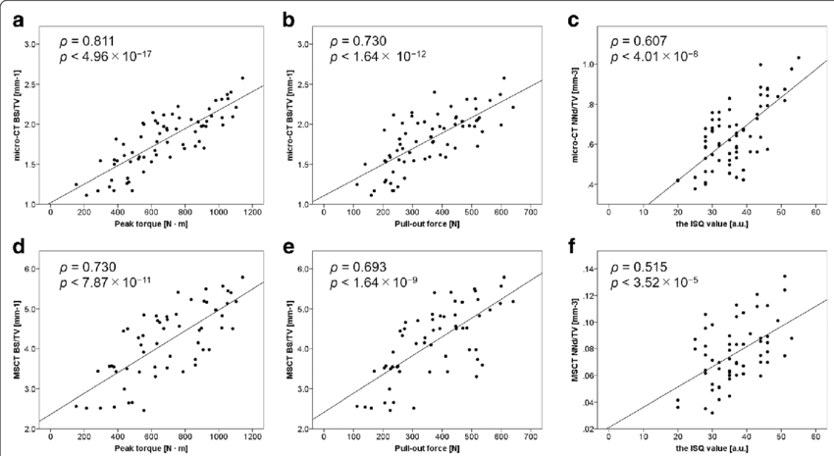
Implications
Linearity plot of all independent variables vs dependent variable (stream)
Questionable streams/views ration

Slide 8
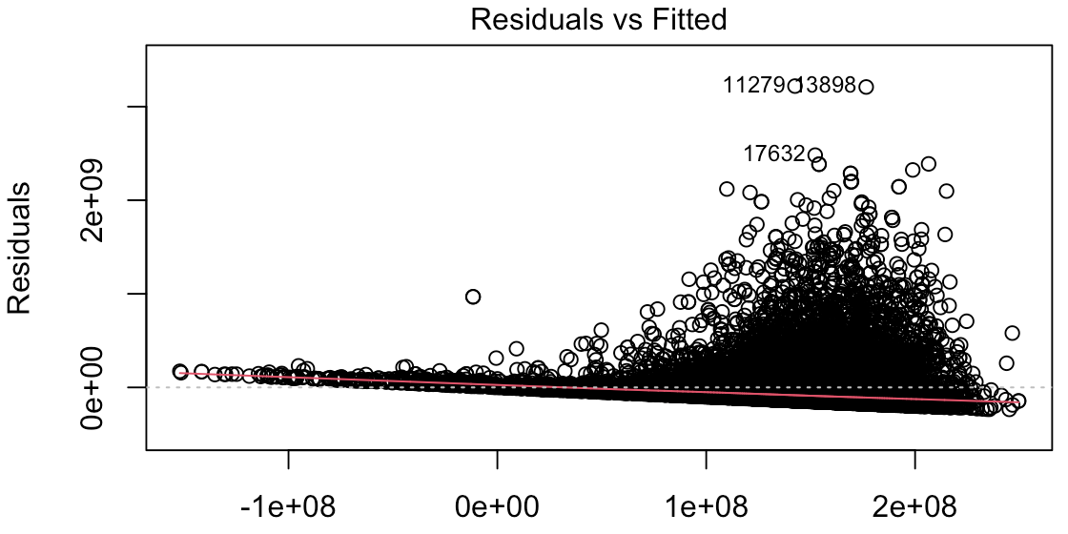
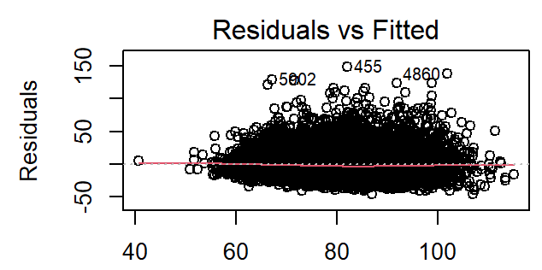
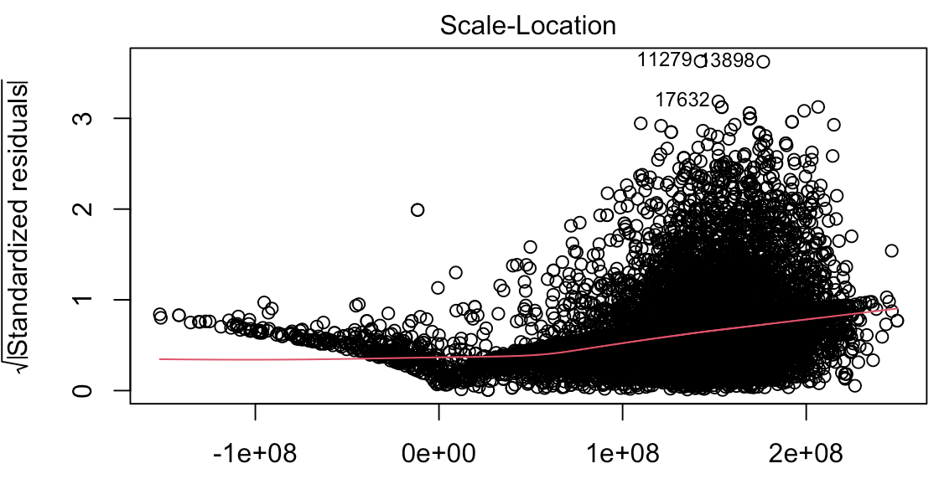
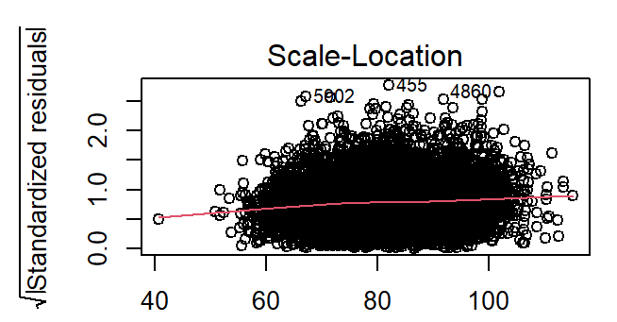
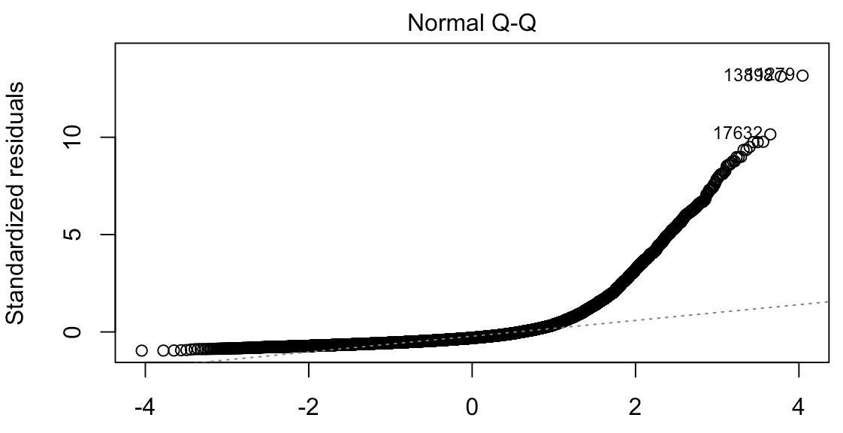
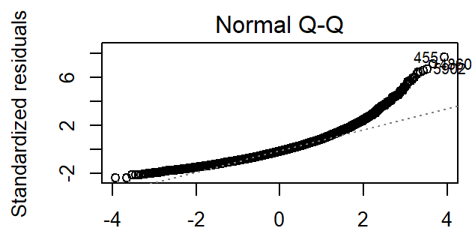
Assumptions
Our plots Desired plots
Independence
Homoscedasticity
Normality of Residuals

Slide 9
06
Discussion
Assumption are violated:
Not really relevant for ML but indicative for a bad dataset/model
Possible alternative explanations:
Popularity of artist
Time since release
Summer song in December
Target Audience (a rapper releasing techno)
Social media attention (viral TikTok sound)
One-hit wonders

